Slide 1
Retina Damage Classification using Transfer Learning
SAT 5114 - Artificial Intelligence In Healthcare
Chandu Narasimhareddyvari
Rishidhar Konathala
Eswar Chalamalasetty

Slide 2
Background of the problem:
Retinal optical coherence tomography (OCT) is an imaging technique used to capture high-resolution cross sections of the retinas of living patients.
Approximately 30 million OCT scans are performed each year, and the analysis and interpretation of these images takes up a significant amount of time .
This presentation delves into the application of a VGG16 neural network for classifying retinal images.

Slide 3
Objective :
The objective is to develop a deep learning model capable of detecting retina damage from OCT images with high accuracy, using transfer learning.
The goal is to automate the detection of certain conditions through image analysis, potentially improving diagnostic processes.

Slide 4
Long-Term Goals and Major Applications
Long-Term Goals:
Applications:
Enhance diagnostic accuracy
Speed up diagnosis
Clinical support tool
Telemedicine platforms
Accessibility and scalability
Reduce healthcare costs
Automated screening platforms
Educational and research tools

Slide 5
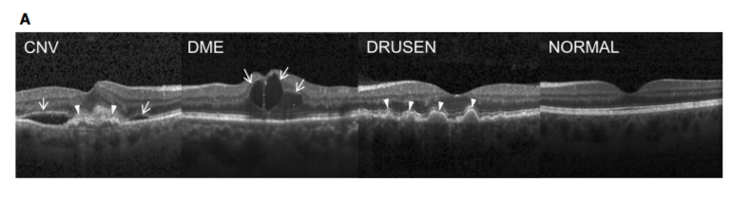
Data set :
Data set obtained from kaggle https://www.kaggle.com/paultimothymooney/kermany2018
The dataset is organized into 3 folders (train, test, val) and contains subfolders for each image category (NORMAL,CNV,DME,DRUSEN). There are 84,495 X-Ray images (JPEG) .
Images are labeled as (disease)-(randomized patient ID)-(image number by this patient) and split into 4 directories: CNV, DME, DRUSEN, and NORMAL .

Slide 6
Data Preprocessing :
Retinal Dataset Splitting :
Data splitting is performed using two directories: 'OCT2017/train' for training data and 'OCT2017/test' for validation data. The ImageDataGenerator class from Keras is used to load and preprocess the images.
Preprocessing includes resizing images to 224x224 pixels, normalization, and data augmentation techniques such as rotation, scaling, and horizontal flipping to enhance the robustness of the model.
The train_generator and validation_generator objects are created using the flow_from_directory method of the train_datagen and validation_datagen objects, respectively. These objects generate batches of tensor image data with real-time data augmentation.

Slide 7
Model Overview :
To build and train a convolutional neural network (CNN) for retinal disease classification. The model architecture is based on VGG16, a pre-trained model on ImageNet, with some modifications .
The model architecture is a VGG16 base model with the last four layers frozen, followed by a fully connected head with a Flatten layer, a Dense layer with 256 neurons and ReLU activation, a Dropout layer with a rate of 0.3, and a Dense layer with 4 neurons and softmax activation.
The model is trained on a retinal disease dataset with data augmentation, and the best model is saved during training.
The Flatten layer deals with the dimensions. Because we have a three-dimensional pixel input image, we use Flatten to turn this into a long, single-dimensional string of numbers.

Slide 8
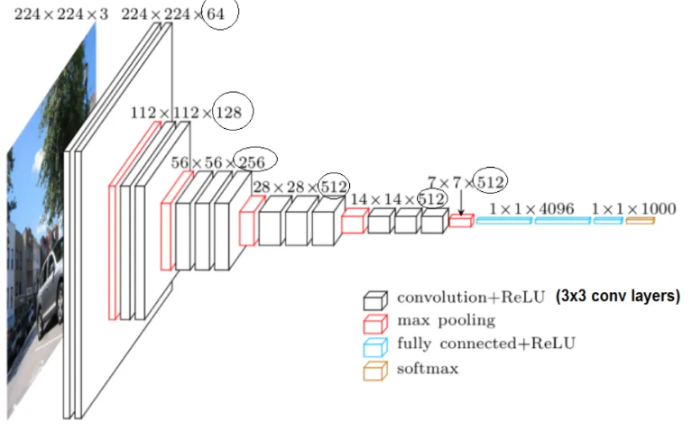
Model Architecture
VGG16

Slide 9
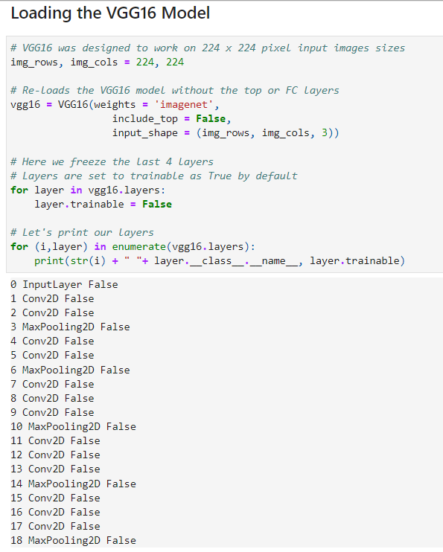
Convolutional Layers:
Total number of layers are 23
One input layer
Convolutional layers are 13
Max-pooling layers are 5 but their parameters will be zero as they have nothing to train in CNN model.
One flatten layer, two dense layers and a dropout layer.
One output layer.

Slide 10
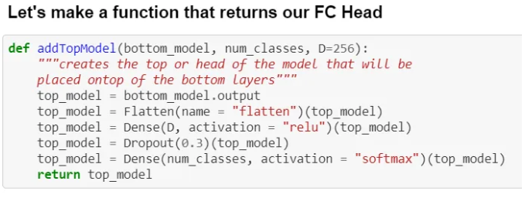
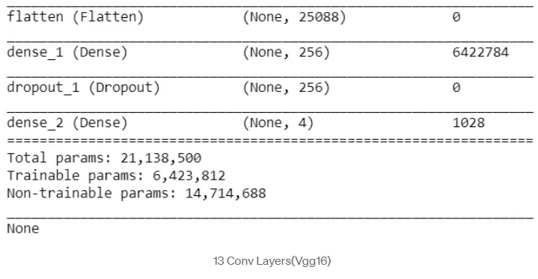
Epochs: 10
Learning Rate: 0.001
Batch Size: 16
Optimizer: Adam

Slide 11
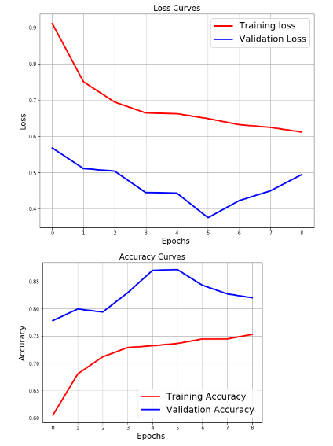
Accuracy Curves and loss curves :

Slide 12
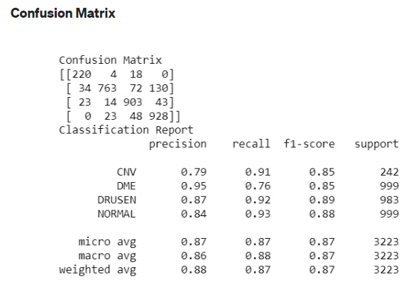
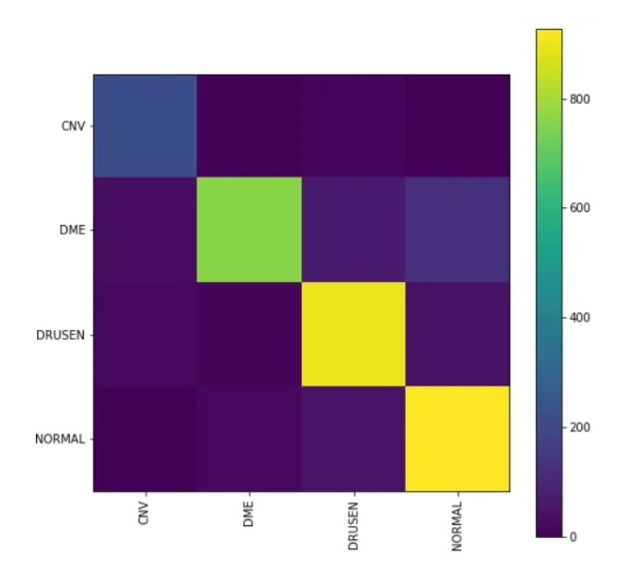
Results :
Test result: 87.217 loss: 0.374
NORMAL,DRUSEN are identified correctly compared to the other retinal diseases

Slide 13
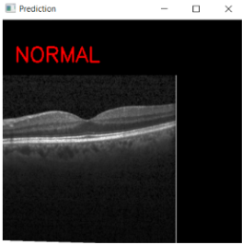
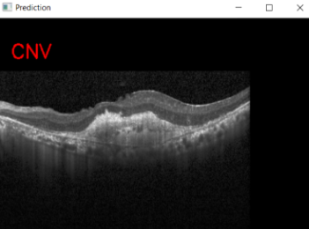
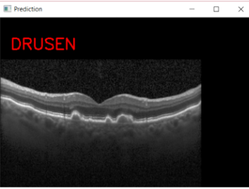
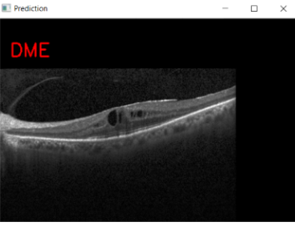
Prediction :

